Slide 1
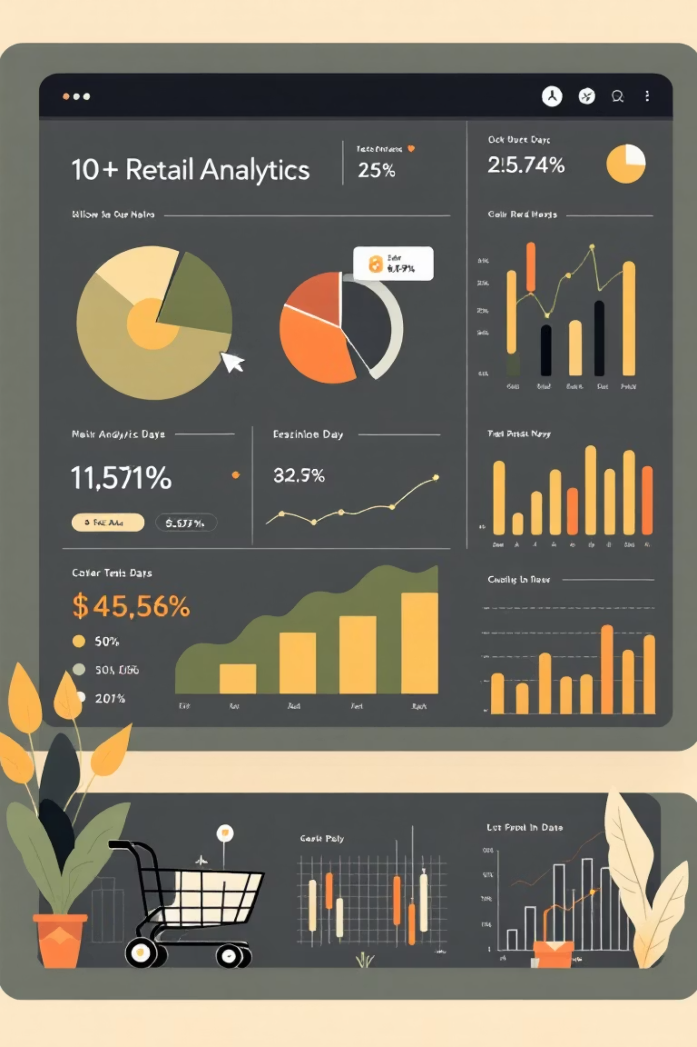
Customer Shopping Behavior Analysis
Analyzing 3,900 customer transactions to uncover spending patterns, preferences, and strategic opportunities for business growth.

Slide 2
Dataset Overview
3,900
18
50
$59.76
Total Purchases
Data Points
Locations
Avg Purchase
Transactions analyzed across all categories
Features covering demographics and behavior
Geographic distribution of customers
Mean transaction value per customer
Customer Demographics
Shopping Behavior
Age, Gender, Location
Product Categories & Preferences
Subscription Status
Discount & Promo Usage
Purchase History
Review Ratings & Shipping

Slide 3

Data Preparation & Cleaning
01
02
Data Loading & Exploration
Missing Data Handling
Imported dataset using pandas, analyzed structure with df.info() and summary statistics
Imputed 37 missing Review Rating values using median rating by product category
03
04
Feature Engineering
Database Integration
Created age_group bins and purchase_frequency_days columns for deeper analysis
Connected to PostgreSQL and loaded cleaned data for SQL business analysis

Slide 4
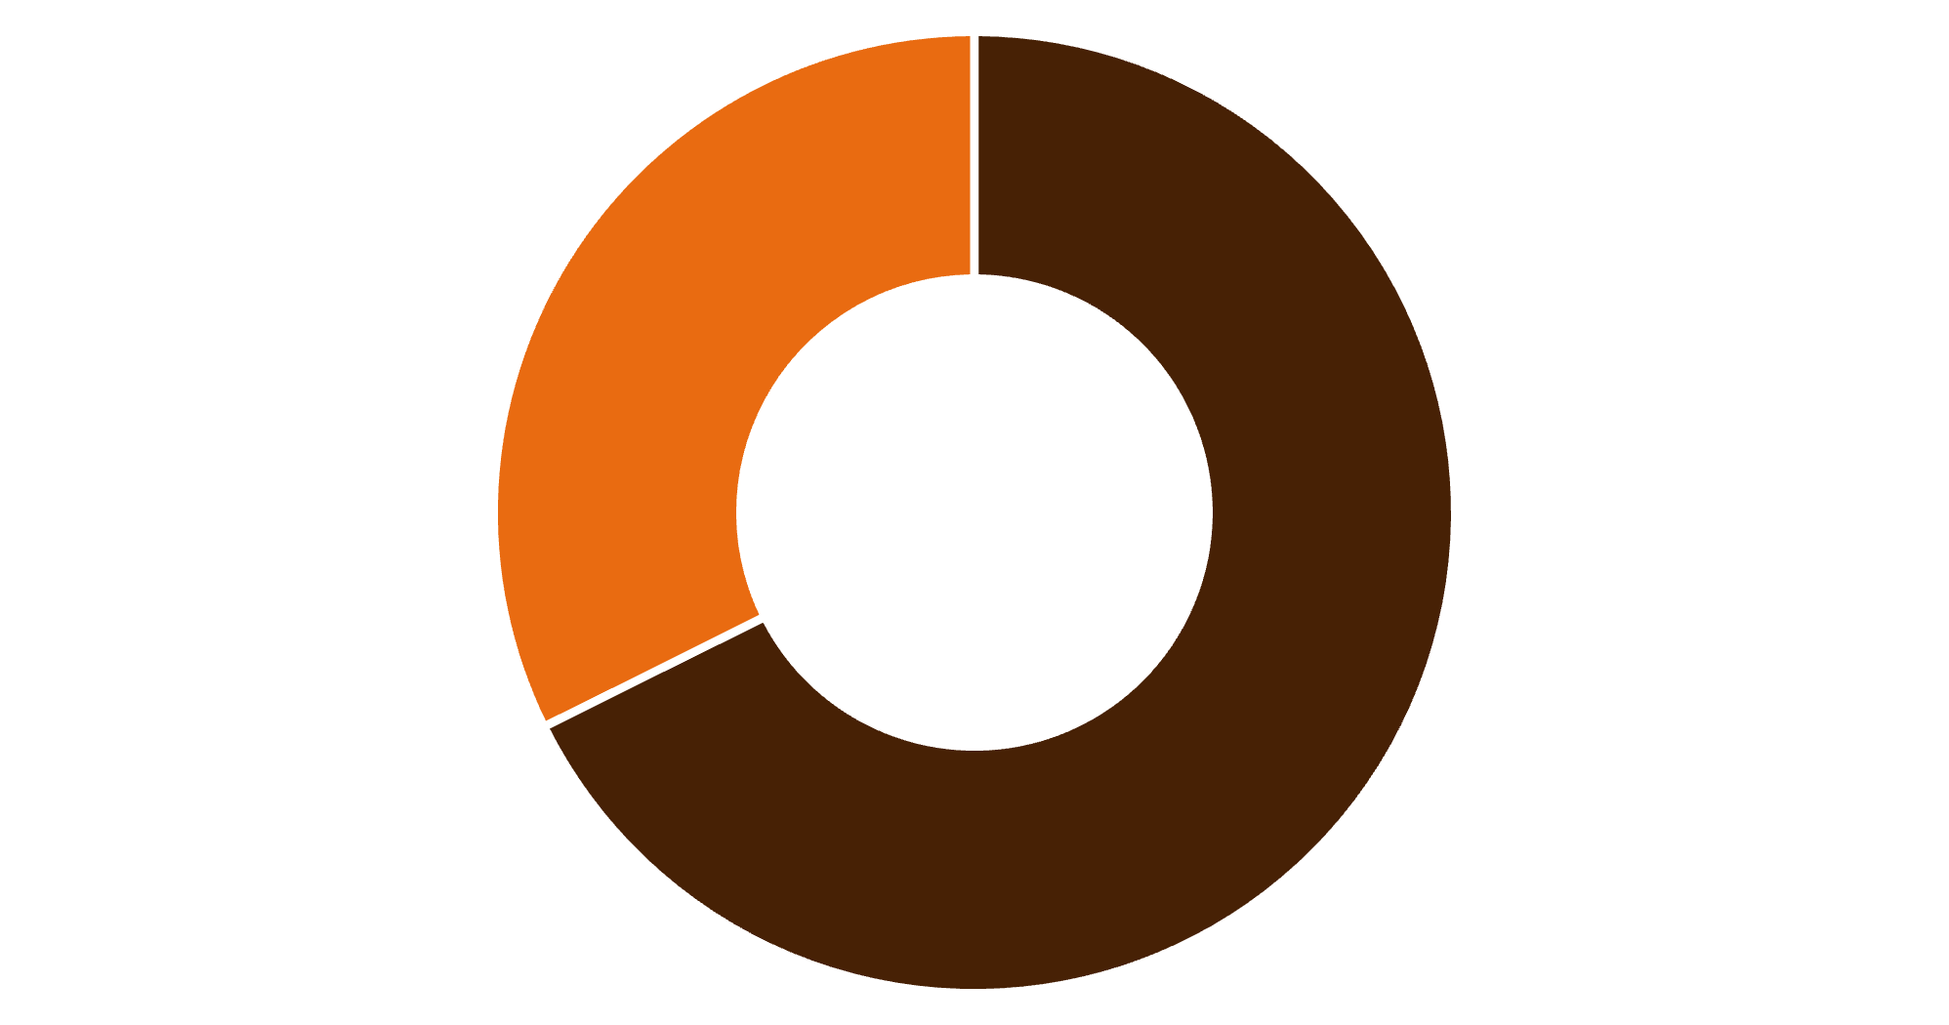
Revenue Insights by Gender
Male Customers Drive Revenue
Male customers generate 68% of total revenue ($157,890) compared to female customers ($75,191).
This significant gap suggests opportunities for targeted marketing to balance gender engagement.
Male
Female

Slide 5

Customer Segmentation Analysis
Loyal Customers
Returning Customers
3,116 customers (80%)
701 customers (18%)
High repeat purchase rate demonstrates strong brand loyalty and satisfaction
Moderate engagement level with growth potential through targeted retention
New Customers
83 customers (2%)
Small but important segment requiring onboarding and first-purchase incentives

Slide 6

Top-Rated Products
77%
77%
76%
Gloves
Sandals
Boots
Highest average rating at 3.86 stars
Strong performance with 3.84 stars
Consistent quality at 3.82 stars
76%
76%
Hat
Skirt
Popular accessory rated 3.80 stars
Top clothing item at 3.78 stars
These top-rated products should be featured prominently in marketing campaigns and inventory planning.

Slide 7

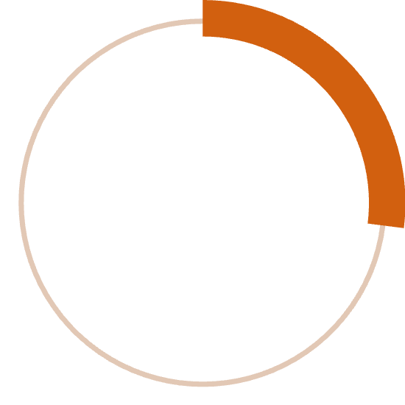

Subscription vs. Non-Subscription Behavior
Key Findings
Similar average spend between groups ($59.49 vs $59.87)
27%
Non-subscribers generate $170,436 total revenue
Subscribers contribute $62,645 total revenue
Massive opportunity to convert 73% non-subscribers
Subscribers
1,053 customers with $59.49 avg spend
73%
Non-Subscribers
2,847 customers with $59.87 avg spend

Slide 8
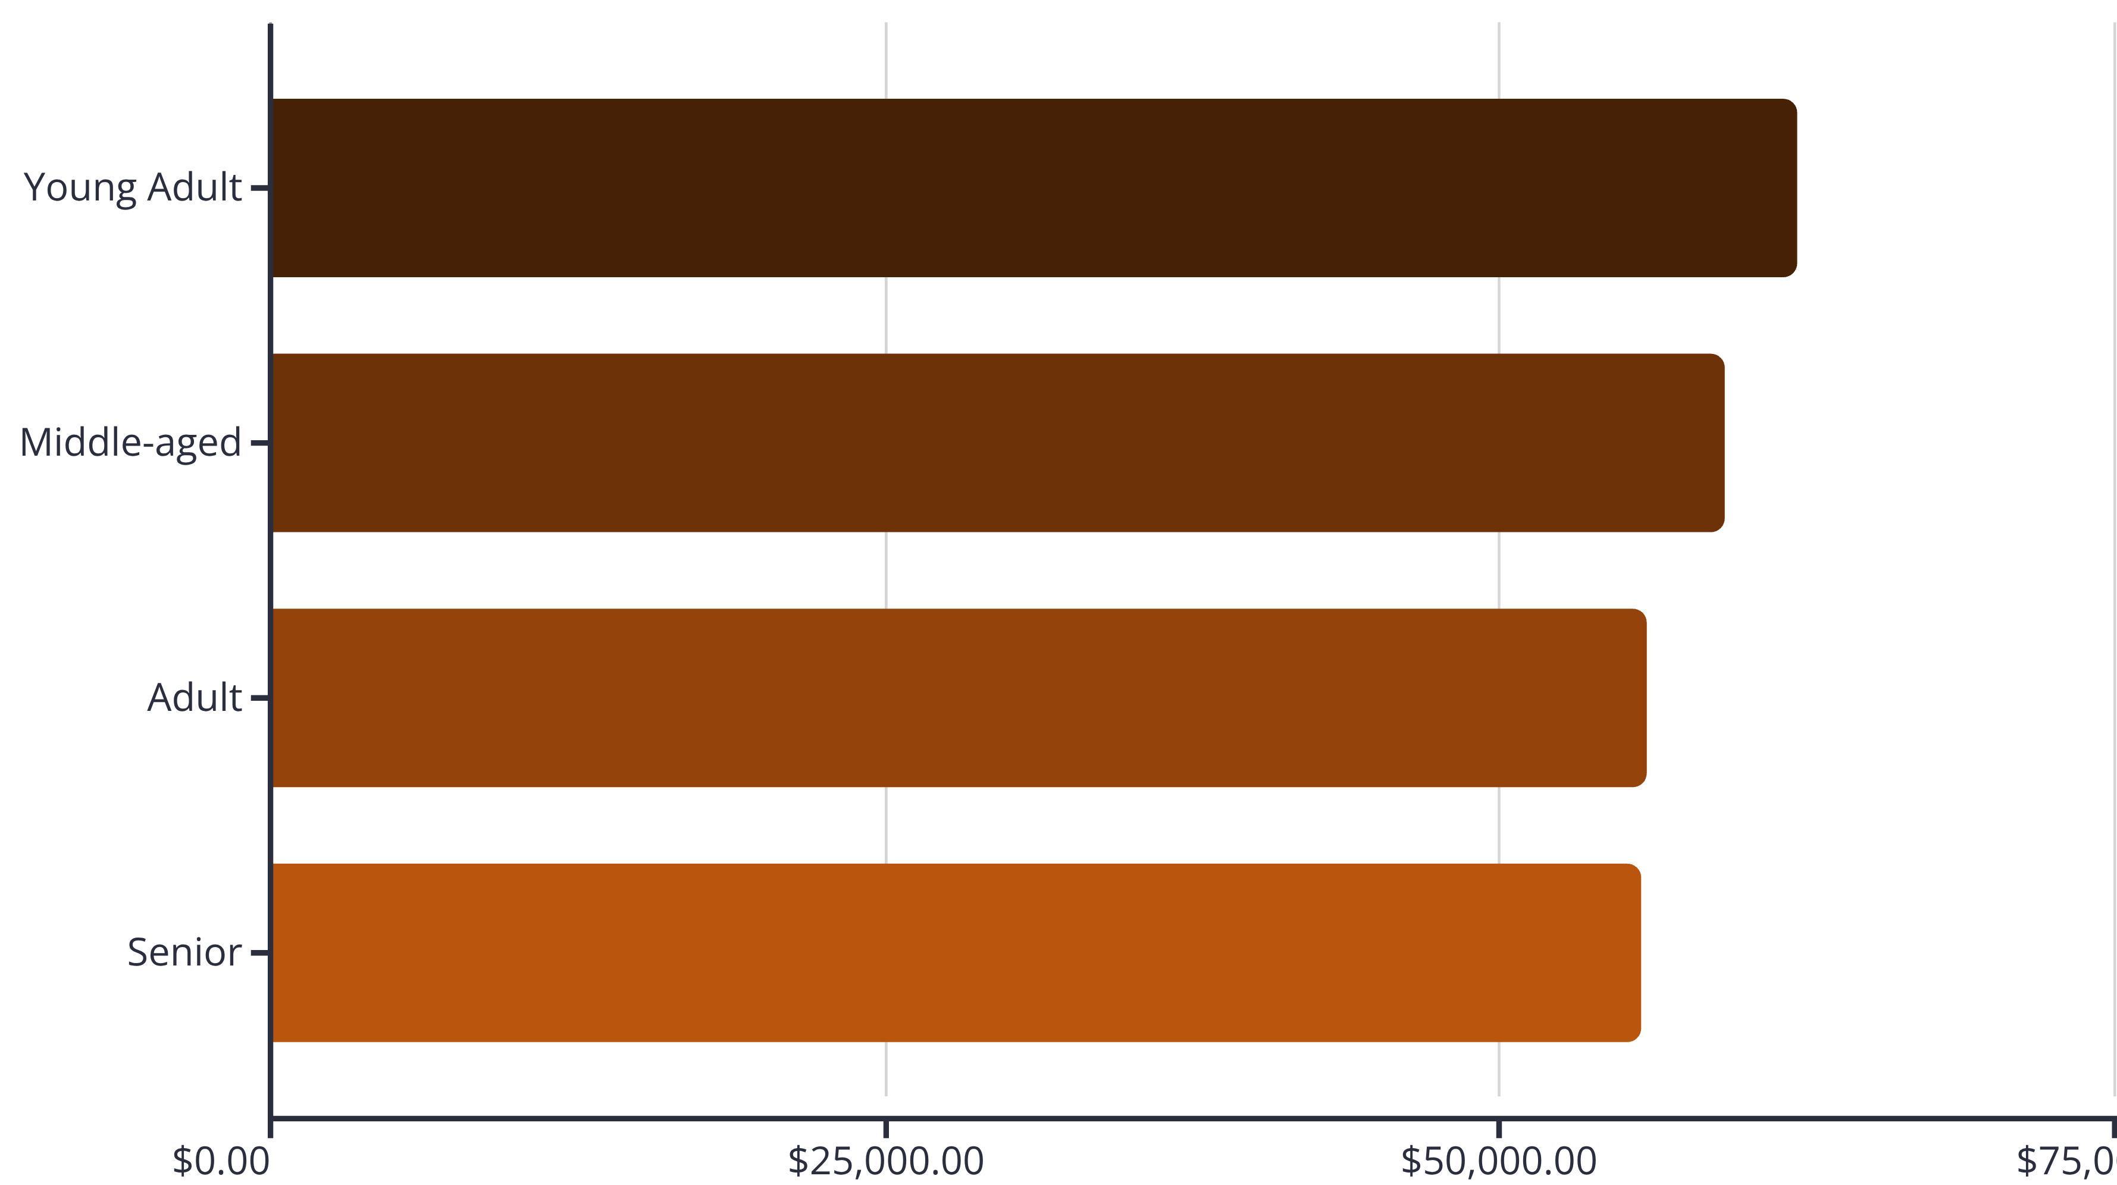
Revenue by Age Group
Young Adults lead revenue generation at $62,143, followed closely by Middle-aged customers. Revenue distribution is relatively balanced across age groups, suggesting broad market appeal.

Slide 9
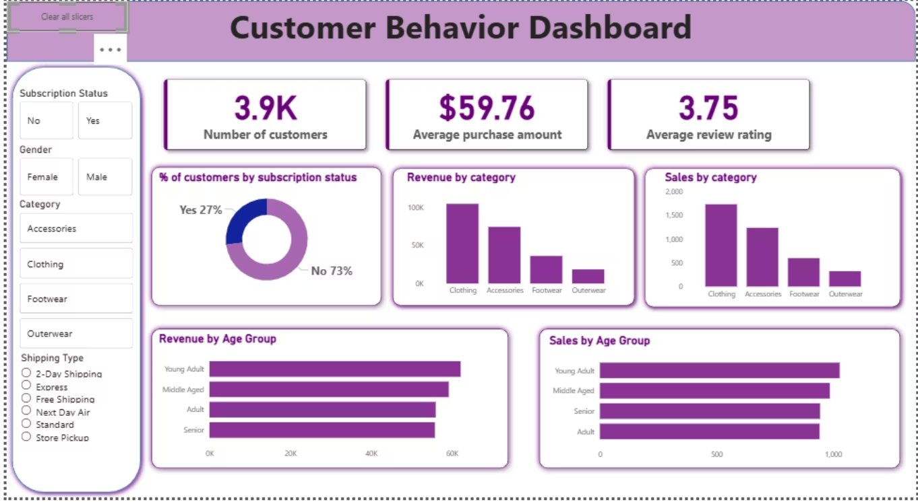
Power BI Dashboard
Interactive Filters
Key Metrics
Visual Insights
Subscription status, gender, category, and shipping type for dynamic analysis
3.9K customers, $59.76 average purchase, 3.75 average rating at a glance
Revenue and sales breakdowns by category, age group, and subscription status

Slide 10



Strategic Recommendations
Boost Subscriptions
Loyalty Programs
Review Discount Policy
Promote exclusive benefits to convert 73% non-subscribers and increase recurring revenue
Reward repeat buyers to strengthen the 80% loyal customer base and increase lifetime value
Balance promotional sales boosts with margin control for sustainable profitability
Product Positioning
Targeted Marketing
Feature top-rated items like Gloves and Sandals in campaigns
Focus on high-revenue Young Adults and express-shipping users

